Slide 1



Lecture 5
Chapter 1. The Foundations
  Nested Quantifiers
  Rules of Inference
5-<number>

Slide 2






Nesting of Quantifiers
 Example:
Let the domain of x and y be people.
Let L(x,y) = “x likes y” (A statement with 2 free variables – not a proposition)
 Then ∃y L(x,y) = “There is someone whom
x likes.” (A statement with 1 free variable x
– not a proposition)
 Then ∀x (∃y L(x,y)) =
“Everyone has someone whom they like.” (A with free variables.)
5-<number>

Slide 3

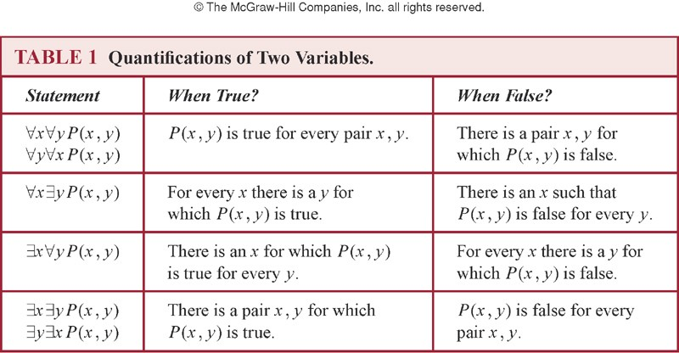
Nested Quantifiers
 Nested quantifiers are quantifiers that occur within the scope of other quantifiers.
 The order of the quantifiers is important, unless all the quantifiers are universal quantifiers or all are existential quantifiers.
5-<number>

Slide 4


Nested Quantifiers
 Let the domain of x and y is R, and P(x,y): xy = 0.
Find the truth value of the following propositions.
 ∀x ∀y P(x, y)
 ∀x ∃y P(x, y)
 ∃x ∀y P(x, y)
 ∃x ∃y P(x, y)
(F)
(T)
(T)
(T)
R: set of real numbers
 ∀x ∃y P(x,y) ≡ ∃y ∀x P(x,y)
 For every x, there exists y such that x + y = 0.
(T)
 There exists y such that, for every x, x + y = 0. (F)
5-<number>

Slide 5
Nested Quantifiers: Example
 Let the domain = {1, 2, 3}. Find an expression equivalent to ∀x ∃y P(x,y) where the variables are bound by substitution instead:
 Expand from inside out or outside in.
 Outside in:
∀x ∃y P(x,y)
≡ ∃y P(1,y) ∧ ∃y P(2,y) ∧ ∃y P(3,y)
≡ [P(1,1) ∨ P(1,2) ∨ P(1,3)] ∧
[P(2,1) ∨ P(2,2) ∨ P(2,3)] ∧
[P(3,1) ∨ P(3,2) ∨ P(3,3)]
5-<number>

Slide 6
Quantifier Exercise
 If R(x,y)=“x relies upon y,” express the following in unambiguous English when the domain is all people
∀x(∃y R(x,y)) = Everyone has someone to rely on.
There’s a poor overburdened soul whom
everyone relies upon (including himself)!
∃y(∀x R(x,y)) =
∃x(∀y R(x,y)) =
There’s some needy person who relies upon everybody (including himself).
∀y(∃x R(x,y)) =
Everyone has someone who relies upon them.
Everyone relies upon everybody, (including themselves)!
∀x(∀y R(x,y)) =
5-8

Slide 7

Negating Nested Quantifiers
 Successively apply the rules for negating
statements involving a single quantifier Example: Express the negation of the statement ∀x ∃y (P(x,y) ∧ ∃z R(x,y,z)) so that all negation symbols immediately precede predicates.
¬∀x ∃y (P(x,y) ∧ ∃z R(x,y,z))
≡ ∃x ¬∃y (P(x,y) ∧ ∃z R(x,y,z))
≡ ∃x ∀y ¬(P(x,y) ∧ ∃z R(x,y,z))
≡ ∃x ∀y (¬P(x,y) ∨ ¬∃z R(x,y,z))
≡ ∃x ∀y (¬P(x,y) ∨ ∀z ¬R(x,y,z))
5-<number>

Slide 8
Equivalence Laws
 ∀x ∀y P(x,y) ≡ ∀y ∀x P(x,y)
∃x ∃y P(x,y) ≡ ∃y ∃x P(x,y)
 ∀x (P(x) ∧ Q(x)) ≡ (∀x P(x)) ∧ (∀x Q(x))
∃x (P(x) ∨ Q(x)) ≡ (∃x P(x)) ∨ (∃x Q(x))
5-<number>

Slide 9

Notational Conventions
 Quantifiers have higher precedence than all logical operators from propositional logic:
(∀x P(x))∧ Q(x)
 Consecutive quantifiers of the same type can be combined:
∀x ∀y ∀z P(x,y,z) ≡ ∀x,y,z P(x,y,z) or even ∀xyz P(x,y,z)
5-<number>

Slide 10

1.5 Rules of Inference
 An argument: a sequence of statements that end with a conclusion
 Some forms of argument (“valid”) never lead from correct statements to an incorrect conclusion. Some other forms of argument (“fallacies”) can lead from true statements to an incorrect conclusion.
 A logical argument consists of a list of (possibly compound) propositions called premises/hypotheses and a single proposition called the conclusion.
 Logical rules of inference: methods that depend on logic alone for deriving a new statement from a set of other statements. (Templates for constructing valid arguments.)
5-<number>

Slide 11

Valid Arguments (I)
 Example: A logical argument
If I dance all night, then I get tired. I danced all night.
Therefore I got tired.
 Logical representation of underlying variables:
p: I dance all night. q: I get tired.
 Logical analysis of argument:
p → q premise 1
p premise 2
∴ q
conclusion
5-<number>

Slide 12

Valid Arguments (II)
 A form of logical argument is valid if whenever every premise is true, the conclusion is also true. A form of argument that is not valid is called a fallacy.
5-<number>

Slide 13
Inference Rules: General Form
 An Inference Rule is
 A pattern establishing that if we know that a set of premise statements of certain forms are all true, then we can validly deduce that a certain related conclusion statement is true.
premise 1
premise 2
···
∴ conclusion
“∴” means “therefore”
5-<number>

Slide 14
Inference Rules & Implications
 Each valid logical inference rule corresponds to an implication that is a tautology.
Inference rule
premise 1 premise 2 ···
∴ conclusion
 Corresponding tautology:
((premise 1) ∧ (premise 2) ∧ ☹) → conclusion
5-<number>

Slide 15

Modus Ponens
p
p → q
∴ q
Rule of Modus ponens
(a.k.a. law of detachment)
“the mode of affirming”

 (p ∧ (p →q)) → q is a tautology
p | q | p | → q | p ∧ (p → q) | (p ∧ (p → | q)) | → | q
T | T | T |  | T | T
T | F | F |  | F | T
F | T | T |  | F | T
F | F | T |  | F | T
 Notice that the first row is the only one where premises are all true
5-<number>

Slide 16
Modus Ponens: Example
p → q : “If it snows today
then we will go skiing”
If
assumed TRUE
p : “It is snowing today”
Then ∴q : “We will go skiing”
is TRUE
p → q : “If n is divisible by 3 then n² is divisible by 3”
assumed TRUE
If
p
: “n is divisible by 3”
: “n² is divisible by 3”
Then ∴q
is TRUE
5-<number>

Slide 17

Modus Tollens

¬q
p → q
∴¬p
Rule of Modus tollens
“the mode of denying”
 (¬q ∧ (p →q)) → ¬p is a tautology
 Example
p → q : “If this jewel is really a diamond then it will scratch glass”
assumed TRUE
If
¬q : “The jewel doesn’t scratch glass”
Then ∴ ¬p
: “The jewel is not a diamond”
is TRUE
5-<number>

Slide 18
More Inference Rules
 | p | Rule of Addition
 | ∴ p ∨ q | Tautology: p → (p ∨ q)
 | p ∧ q | Rule of Simplification
 | ∴ p | Tautology: (p ∧ q) → p
 | p q | Rule of Conjunction
 | ∴ p ∧ q | Tautology: [(p) ∧ (q)] → p ∧ q
5-<number>

Slide 19
Examples
 State which rule of inference is the basis of the following arguments:
 It is below freezing now. Therefore, it is either below freezing or raining now.
 It is below freezing and raining now. Therefore, it is below freezing now.
 p: It is below freezing now.
q: It is raining now.
 p → (p ∨ q) (rule of addition)
 (p ∧ q) → p (rule of simplification)
5-<number>

Slide 20
Hypothetical Syllogism
p → q
q → r
∴p → r
Rule of Hypothetical syllogism
Tautology:
[(p → q) ∧ (q → r)] → (p → r)

 Example: State the rule of inference used in
the argument: _{p}
q
“If it rains today, then we will not have a
q
barbecue today. If we do not have a barbecue today, then we will have a barbecue tomorrow.^{r} Therefore, if it rains today, then we will have
p
barbecue tomorrow.”
r
5-<number>

Slide 21
Disjunctive Syllogism
p ∨ q
¬p
∴ q
Rule of Disjunctive syllogism

Tautology: [(p ∨ q) ∧ (¬p)] → q
 Example
 Ed’s wallet is in his back pocket or it is on
his desk. (p ∨ q)
p q
 Ed’s wallet is not in his back pocket. (¬p)
 Therefore, Ed’s wallet is on his desk. (q)
5-<number>

